Slide 1

WALMART SALES PERFORMANCE
AN SQL ANALYSIS PROJECT KEYFINDINGS AND BUSINESSIMPLICATIONS

Slide 2

INTRODUCTION
Walmart, a leading retail chain with a wide range of products and operations across severalcities.
This project analyzes detailed transaction data encompassing customer demographics,product lines, sales figures, and payment methods.
Objective: To leverage advanced SQL techniques to extract actionable insights into salesperformance, customer behavior, and operational efficiencies.
The analysis aims to provide data-driven recommendations for optimizing Walmart's salesstrategies.

Slide 3
DATASET OVERVIEW
The dataset contains historicaltransaction records from Walmart stores.
Key information includes:
Transaction Details: Invoice ID, Date,Time, Total Sales, Tax.
Product Information: Product Line, UnitPrice, Quantity.
Store Information: Branch, City.
Customer Information: Customer Type,Gender, Customer ID.
Payment Information: Payment.
Financial Information: Cost of GoodsSold (cogs), Gross Income, GrossMargin Percentage, Rating.

Slide 4
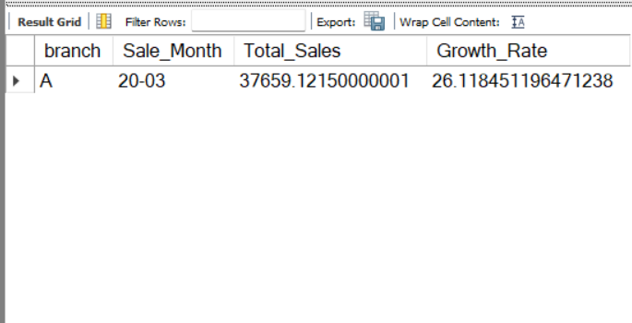
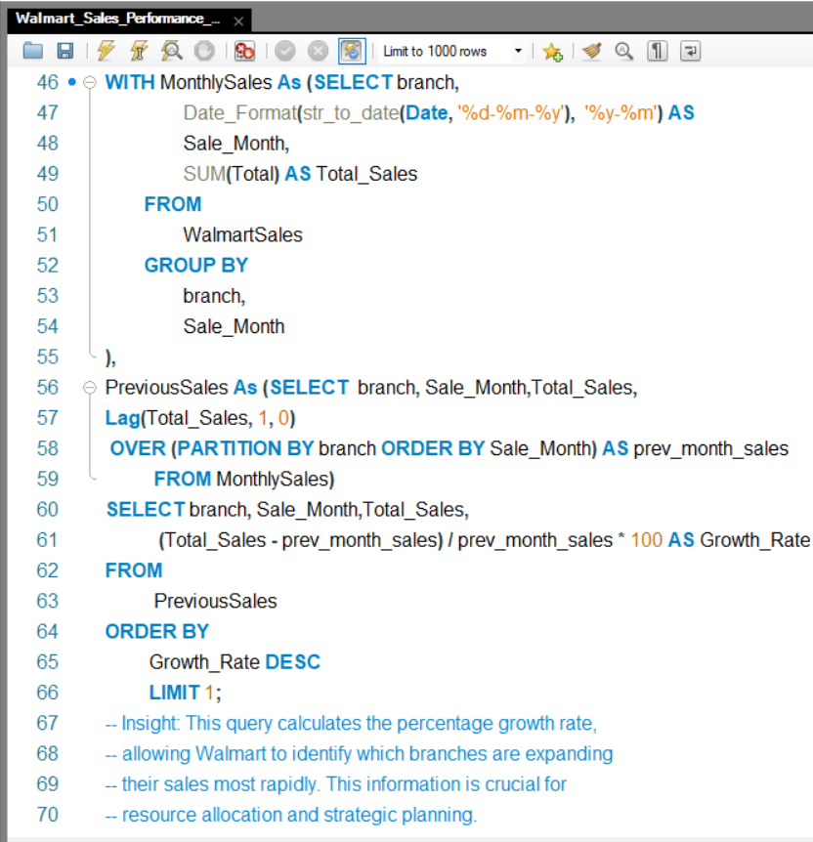
Top Growing Branch
BRANCH | GROWTH RATE
A | 26.11

Slide 5
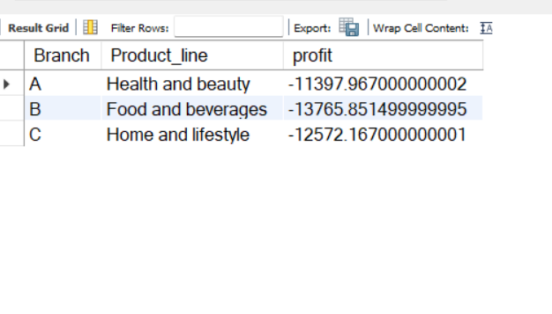
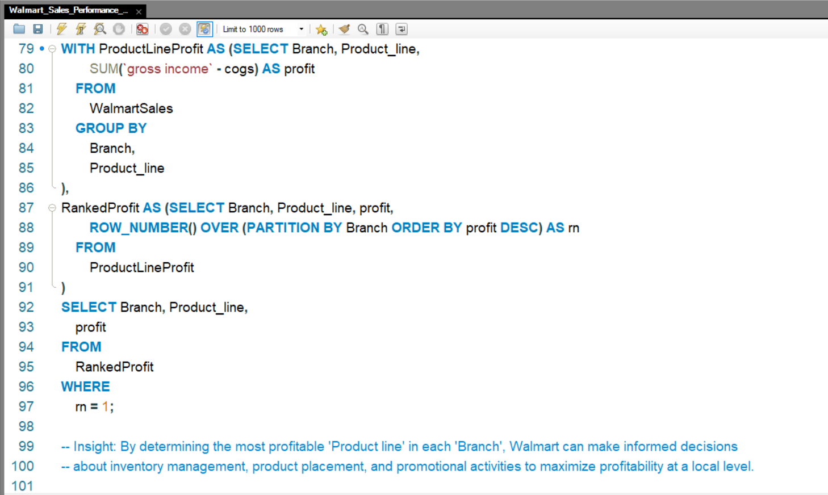
2. Most Profitable Products by Branch
BRANCH | PRODUCT LINE | PROFIT
A | HEALTH & BEAUTY | -11397.967000000002
B | FOOD & BEVERAGES | -13765.851499999995
C | HOME & LIFESTYLE | -12572.167000000001

Slide 6
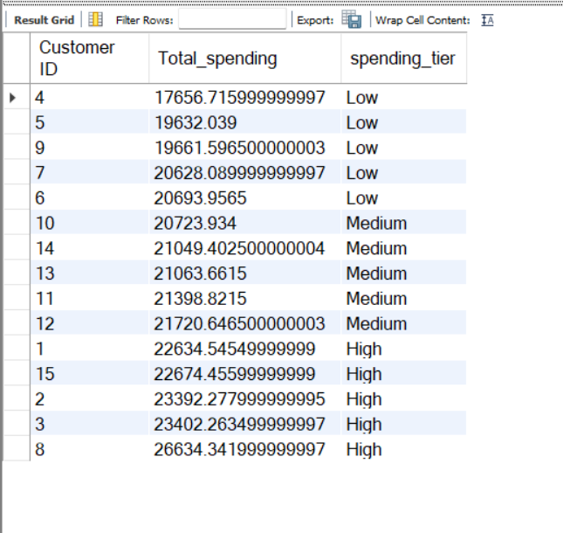
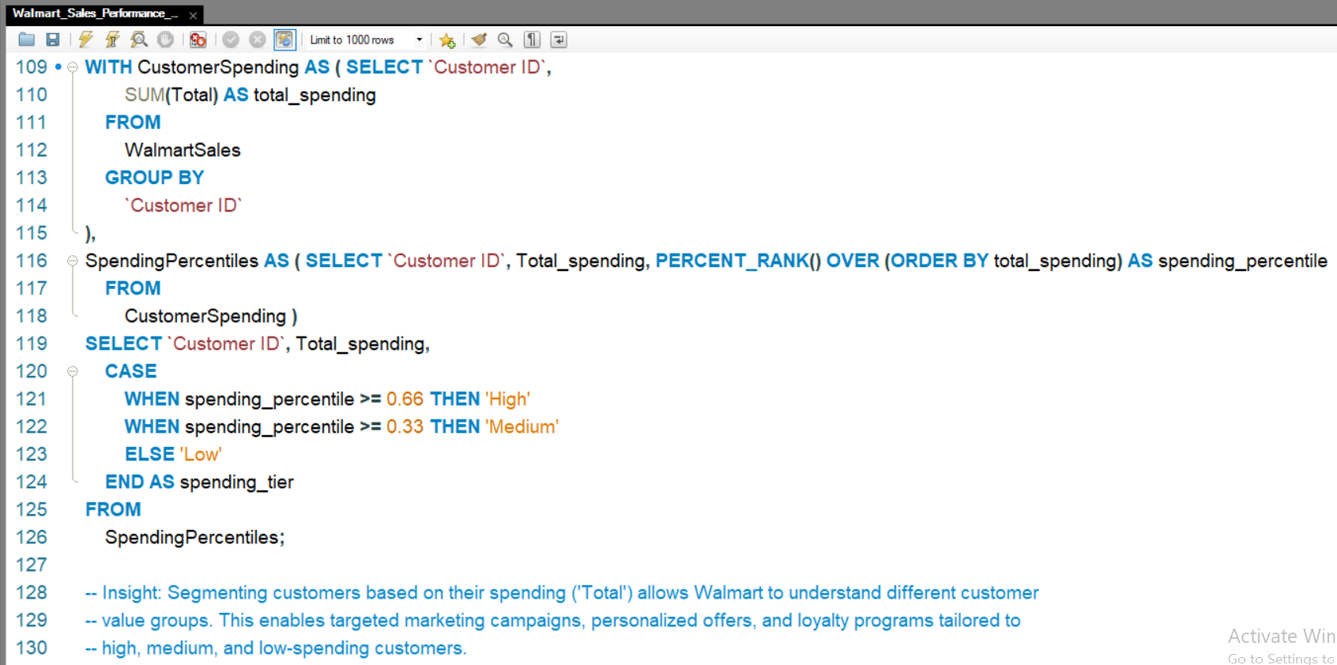
3. Customer Spending Segments

Slide 7
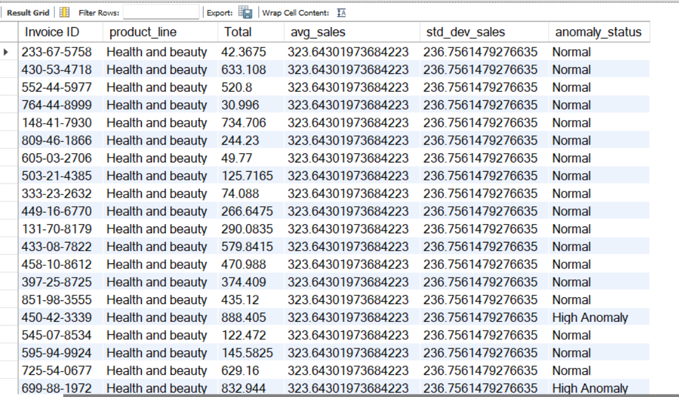
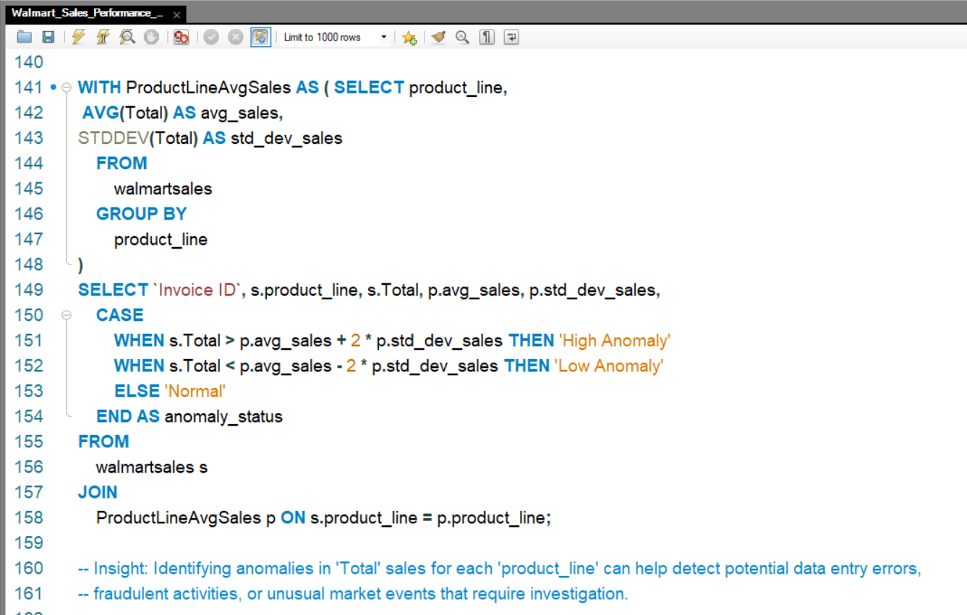
4. Sales Anomaly Detection

Slide 8
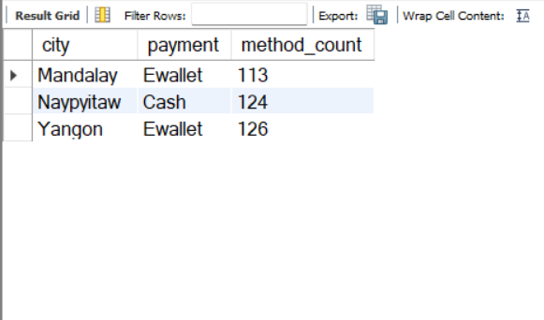
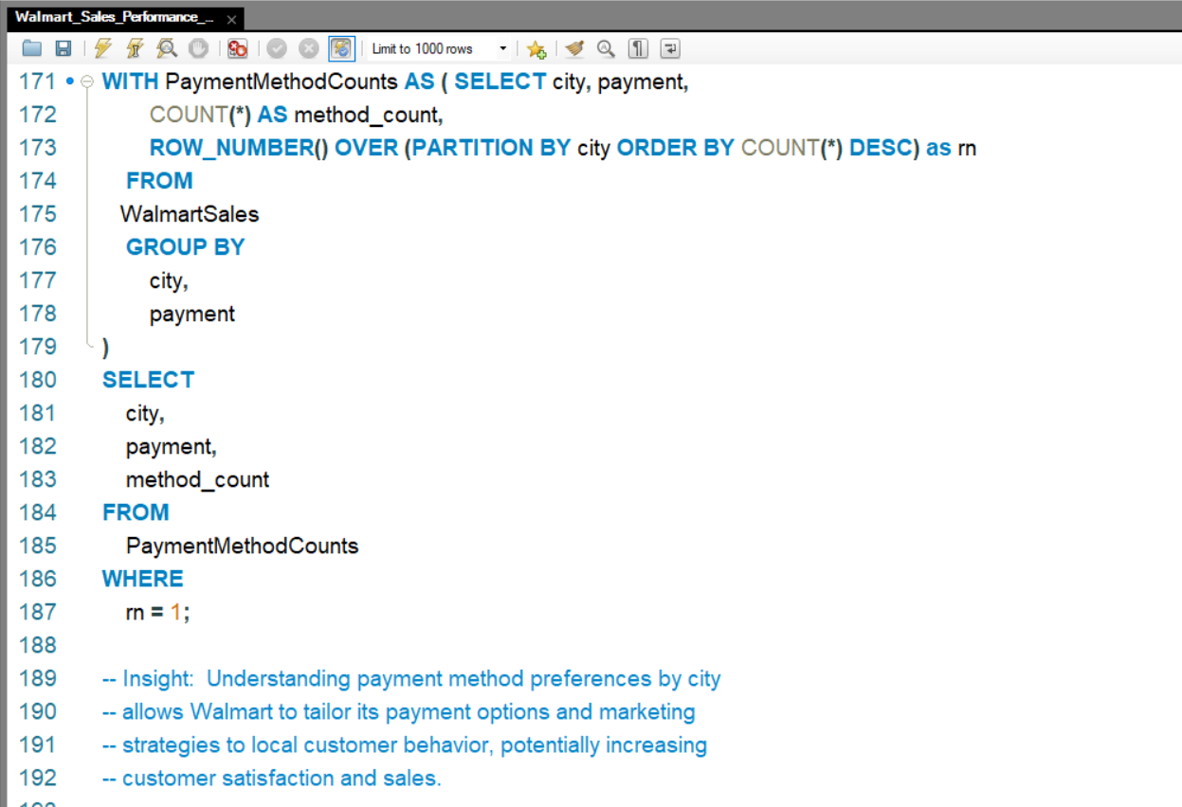
5. Most Popular Payment Method by City
CITY | PAYMENT | METHOD COUNT
MANDALAY | EWALLET | 113
NAYPYITAW | CASH | 124
YANGON | EWALLET | 126

Slide 9
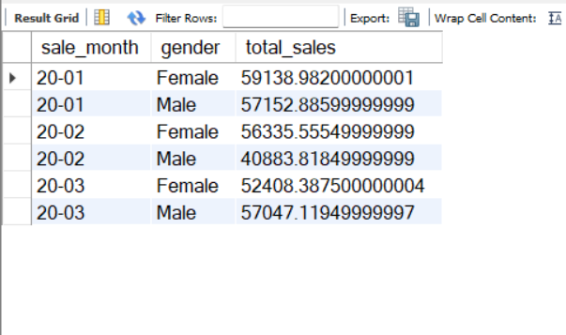
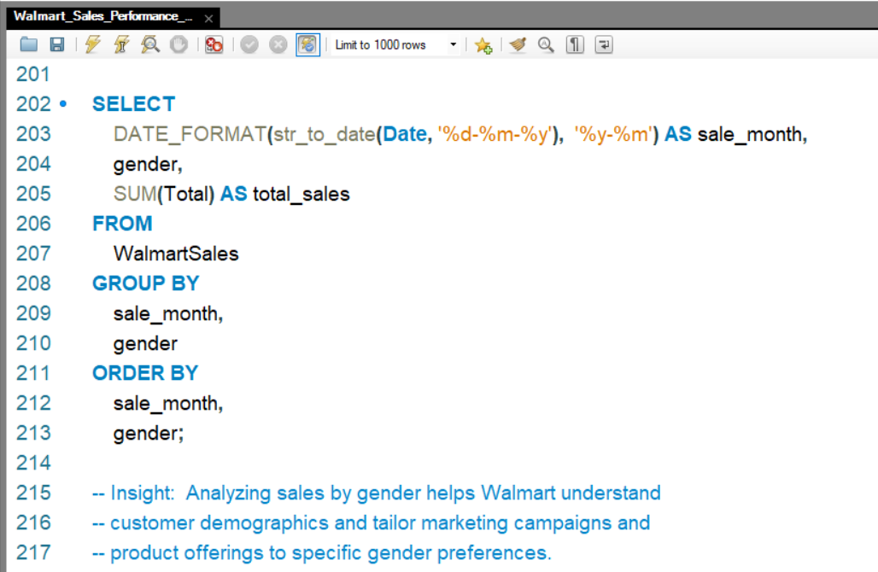
6. Monthly Sales Distribution by Gender

Slide 10
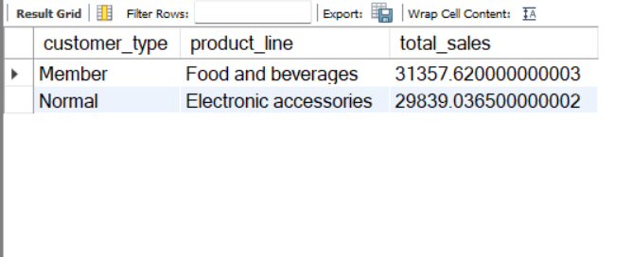
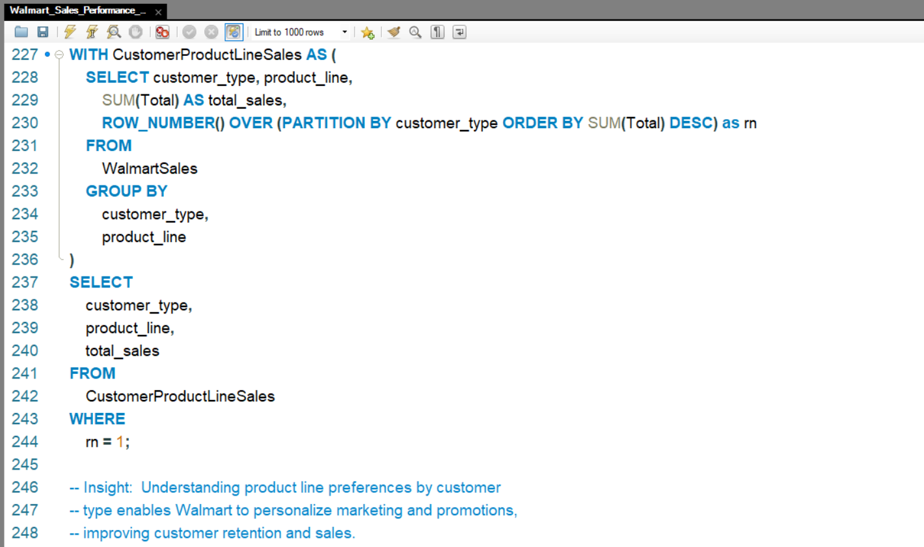
7. What Different Customers Buy Most

Slide 11
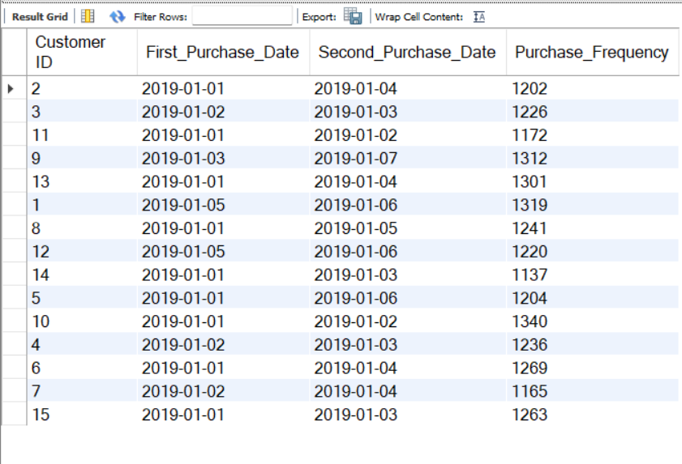
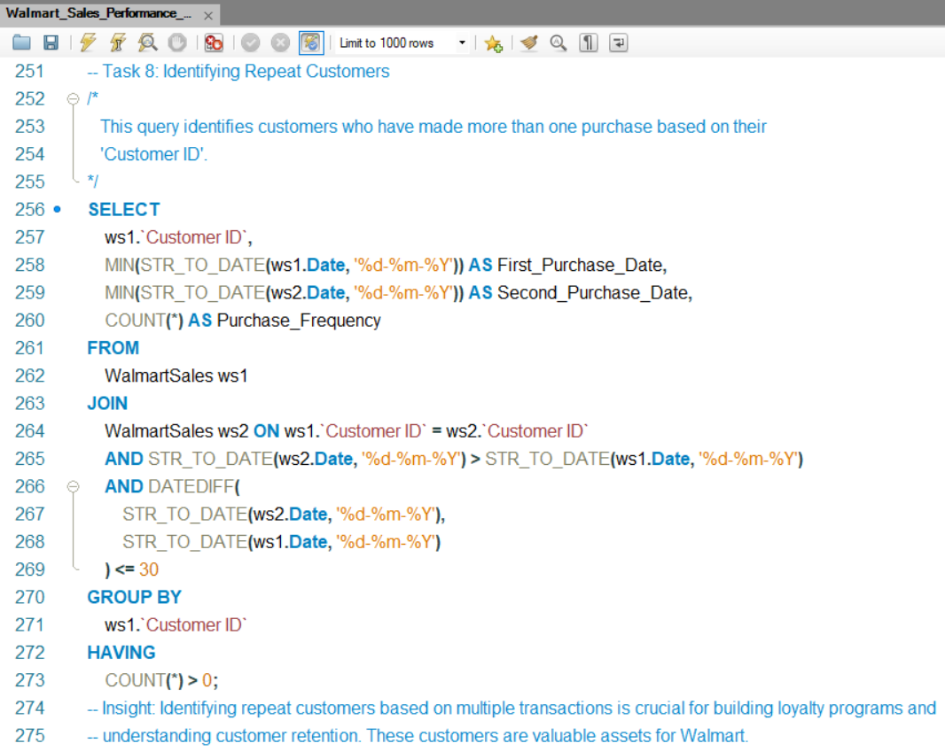
8. Returning Customers

Slide 12
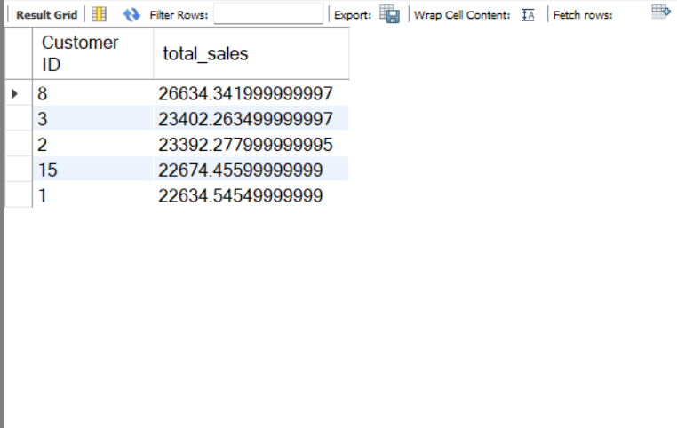
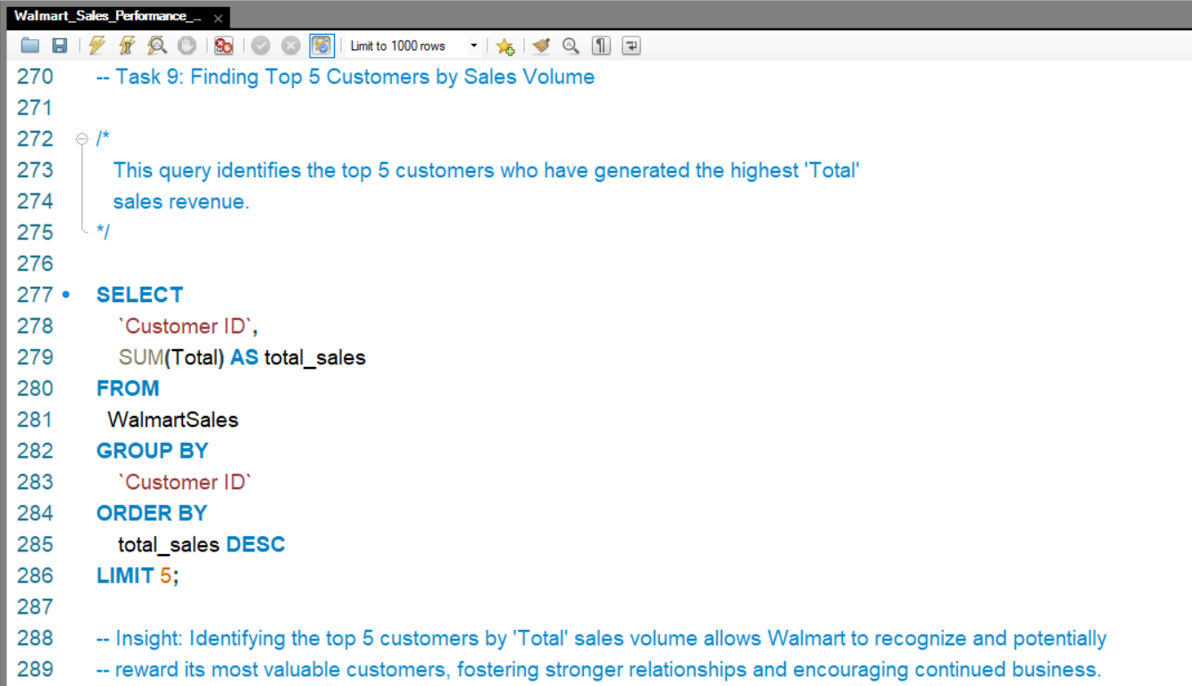
9. Top 5 Customers by Sales

Slide 13
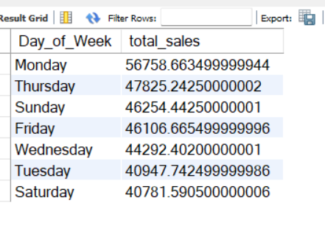
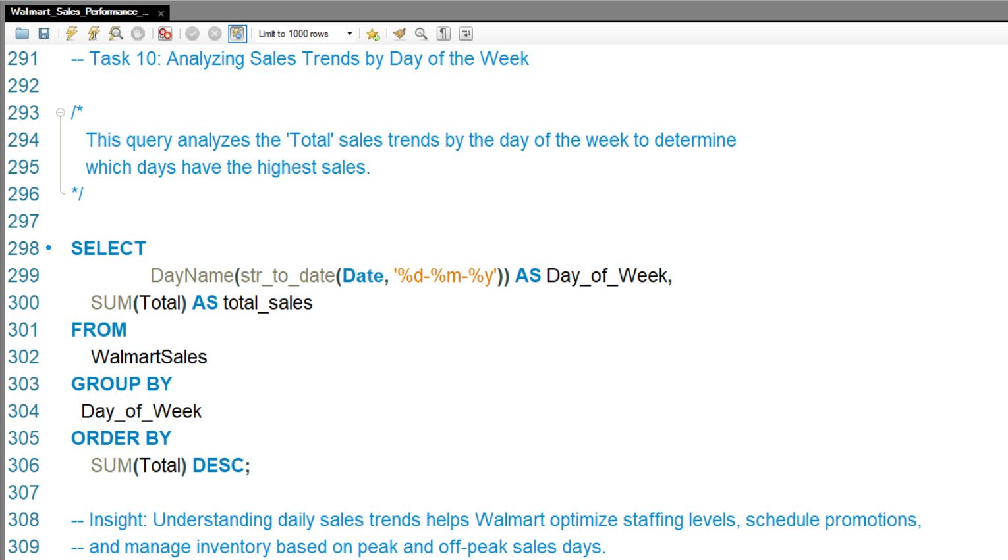
10. Sales Trends by Day of Week

Slide 14
VIDEO LINK
https://drive.google.com/file/d/1feYMYqxGRYIiXsF_QHwwixM1Ha0Lxkbl/view?usp=sharing

